Slide 1
MOVIES ON STREAMING PLATFORMS
Team Members: AnnMarie Morrison, Mercy Griffin, Taniya Chhabra

Slide 2


Which streaming platform has the most movies?

Slide 3
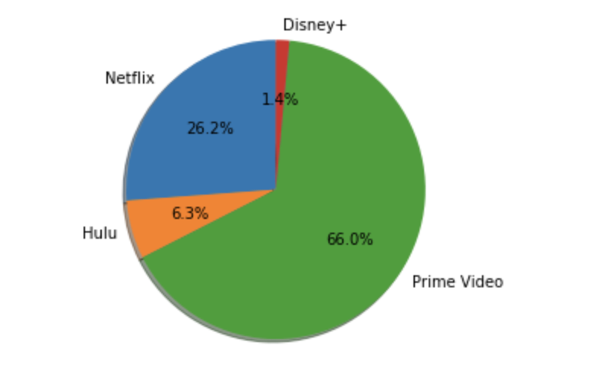
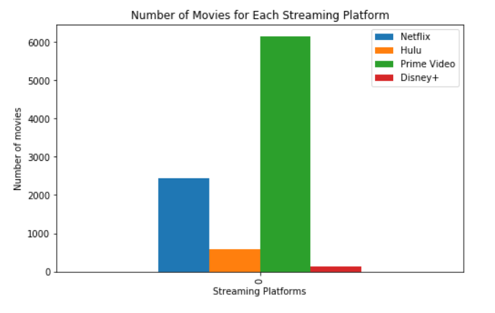

Slide 4
Which streaming platform has the greatest number of popular movies?

Slide 5
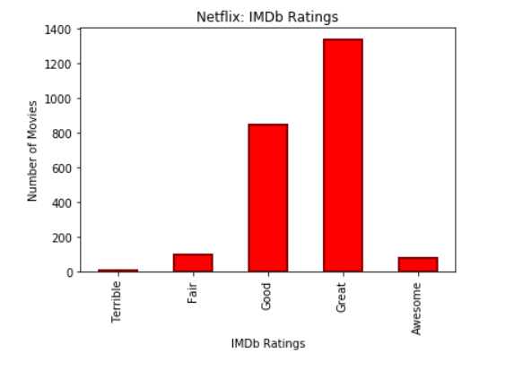
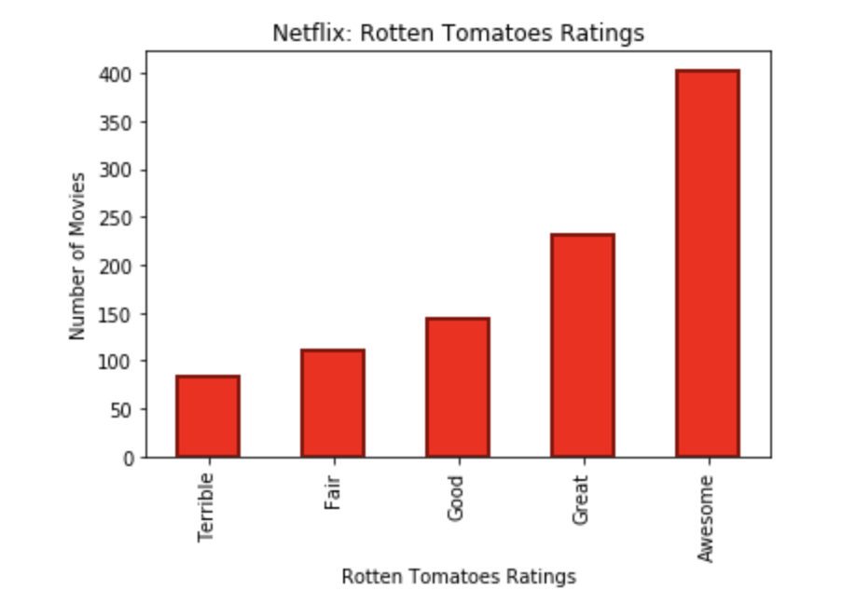
Netflix Ratings

Slide 6
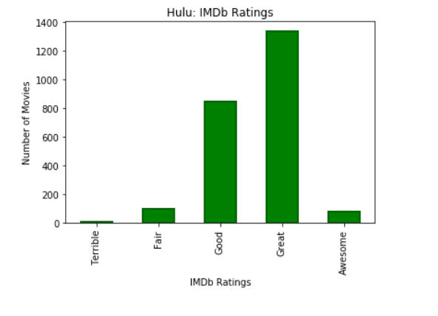
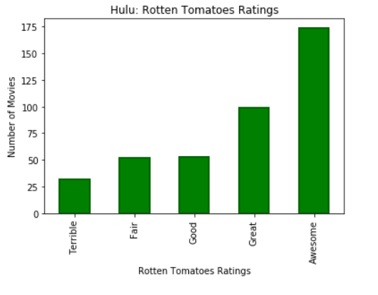
Hulu Ratings

Slide 7
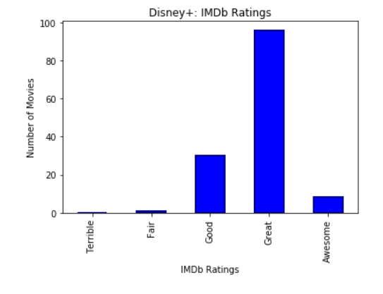
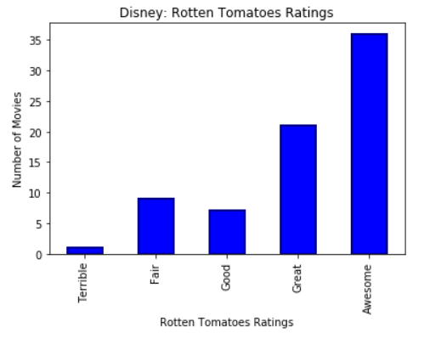
Disney+ Ratings

Slide 8
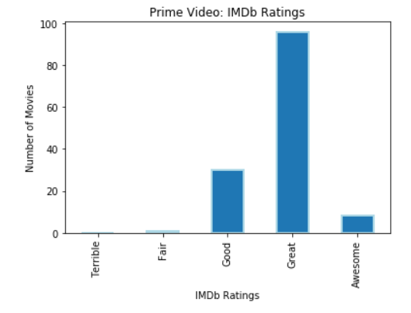
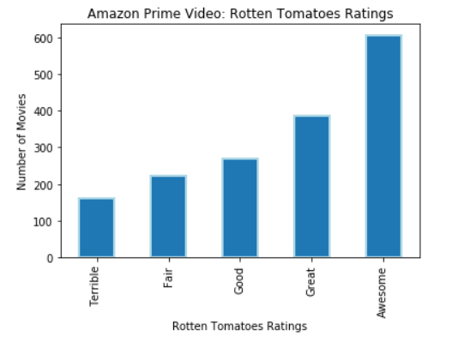
Amazon Prime Video Ratings

Slide 9
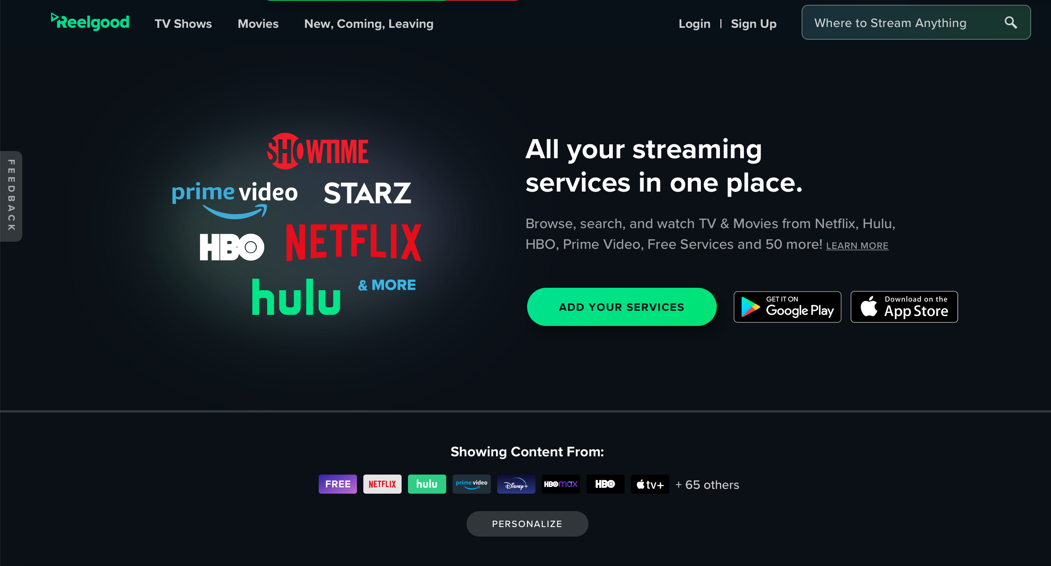
Limitations

